Slide 1


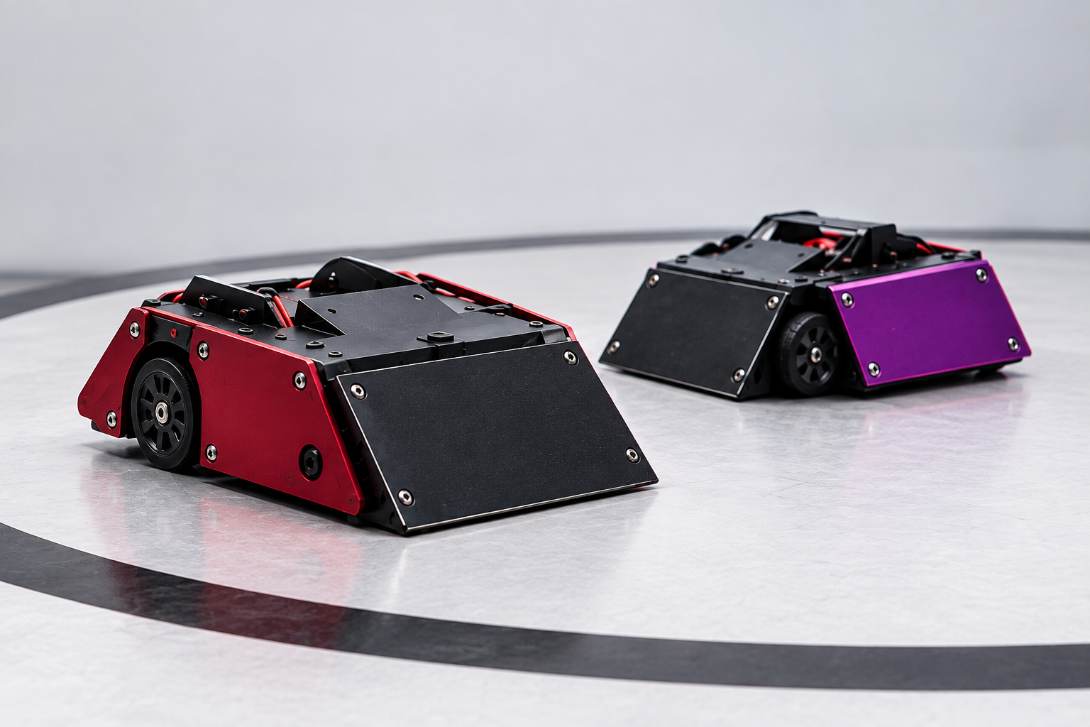
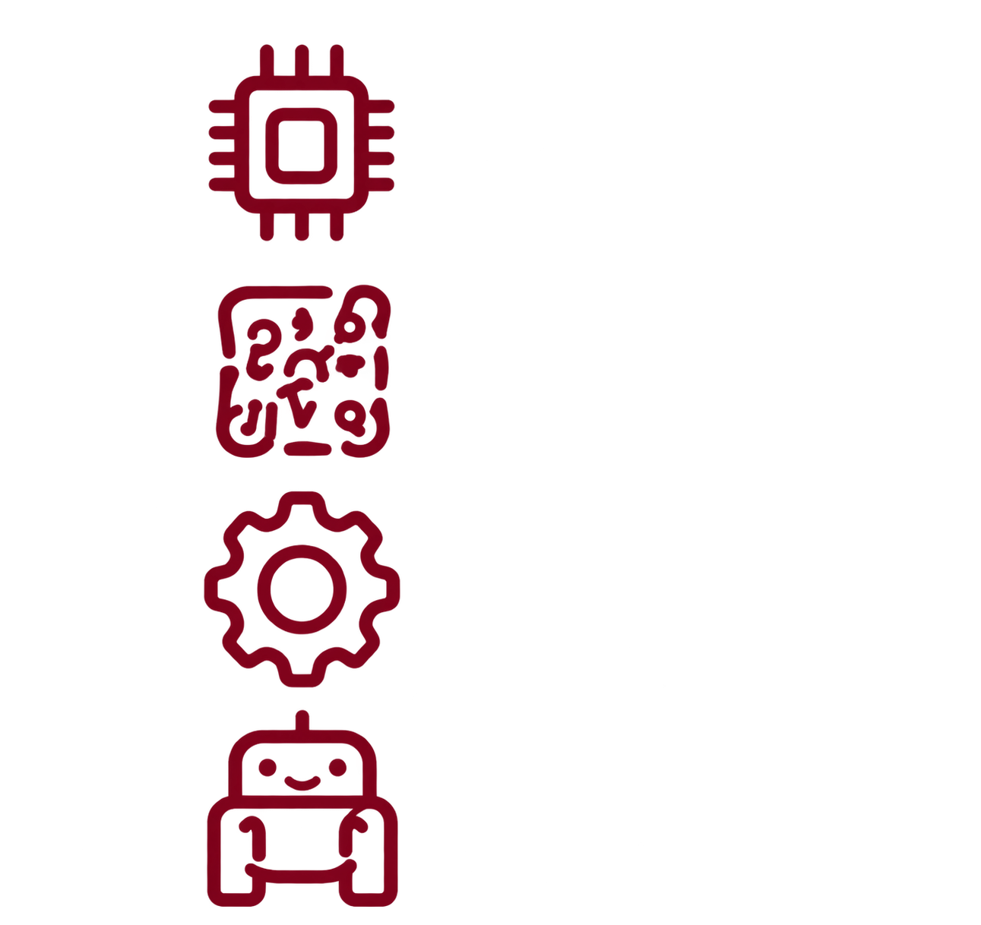


Robotics Workshop
From Electronics to
Sumo Robot
Microcontrollers
Electronics
Sensors & Motors
Sumo Robot Competition
SESSION 1

Slide 2
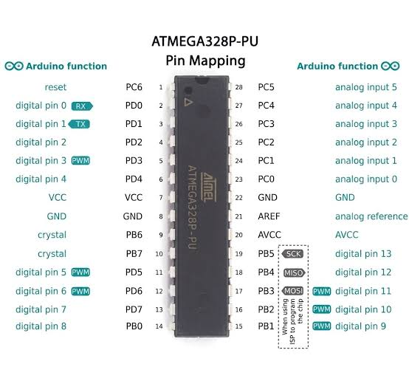
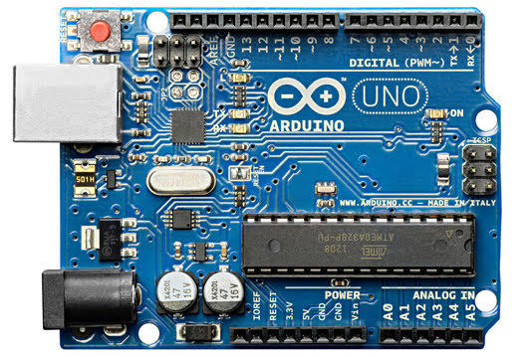
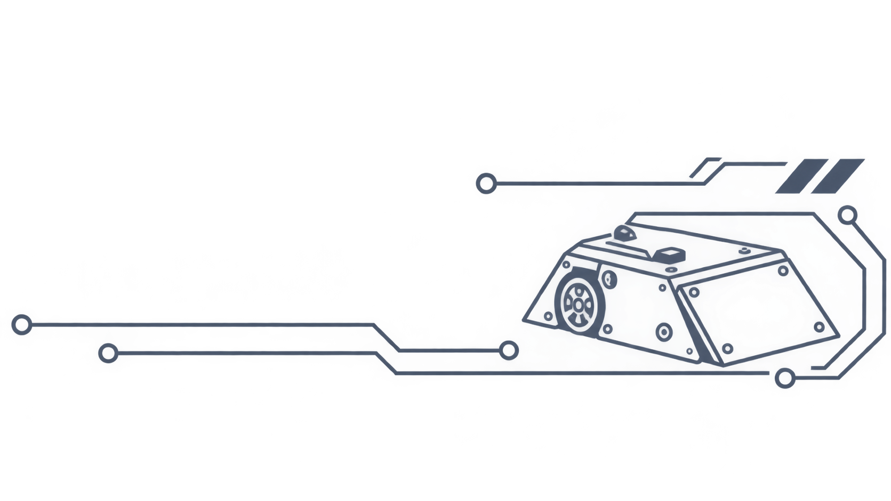
01
Hands-On Robotics Workshop
What is a Microcontroller?
An integrated circuit that combines a microprocessor, memory, and peripheral interfaces on a single chip is known as a microcontroller.
Arduino UNO
ATmega32P
SESSION 1

Slide 3
02
Hands-On Robotics Workshop
Arduino UNO
Digital Pins
From 0 to 13
Special Func.
0,1 RX,TX
3,5,6,9,10,11 PWM
13 Built-in LED
Power Pins
Analog Pins
3.3V & 5V
GND
Vin
From A0 to A5
SESSION 1

Slide 4
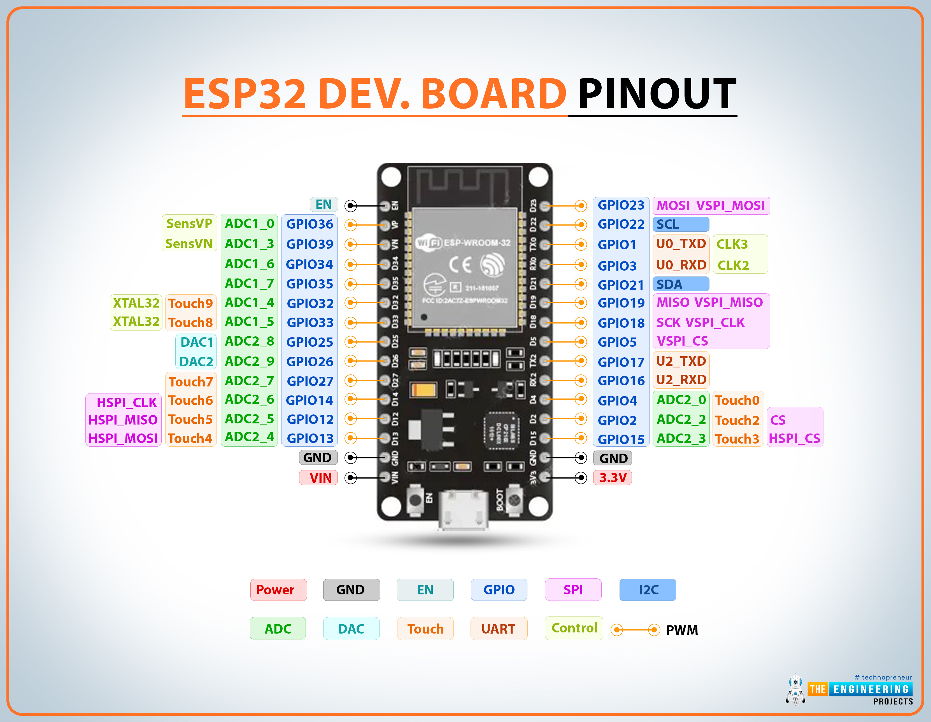
03
Hands-On Robotics Workshop
ESP32
GPIO Pins (Digital I/O):
GPIO 2, 4, 5, 18, 19, 21, 22, 23
Analog Pins (ADC):
GPIO 32 → 39
*Note: these pins are input only
Boot/Strapping Pins (Be Careful):
These affect startup behavior:
GPIO 0
GPIO 2
GPIO 12
GPIO 15
Pins to avoid (Be careful):
GPIO 6–11 → used internally for flash memory
GPIO 34–39 → input only (no output)
SESSION 1

Slide 5
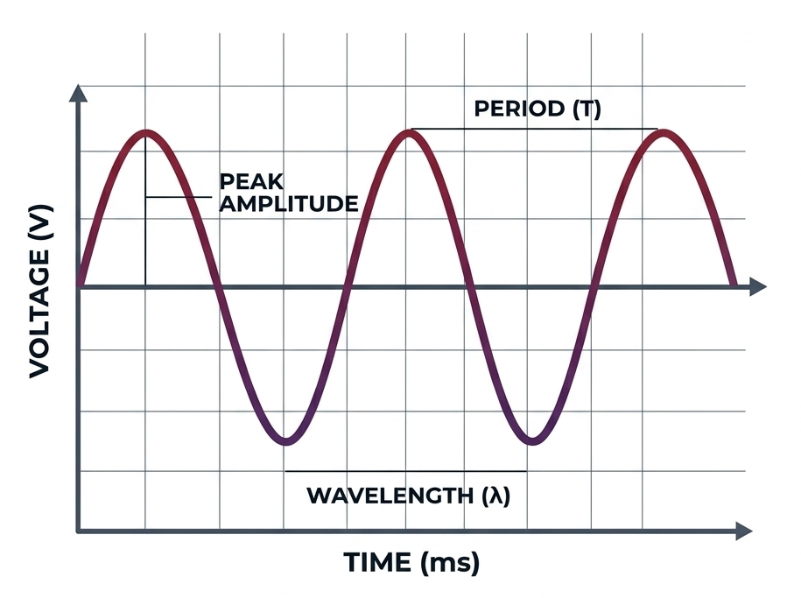
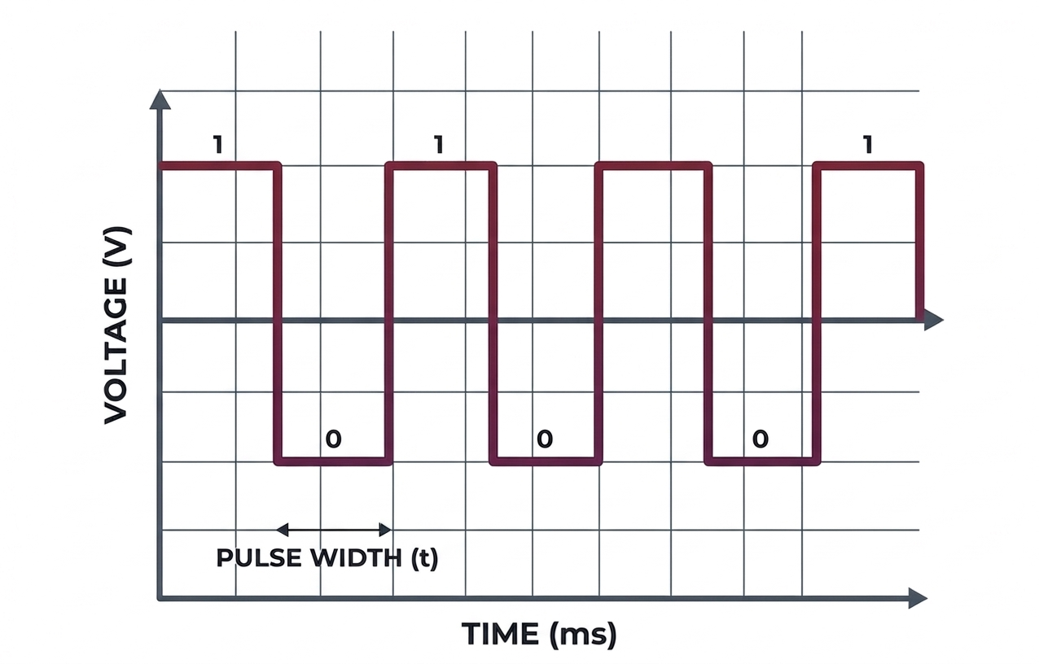
04
Hands-On Robotics Workshop
Signal Types
Analog signal
Digital signal
ADC
ADC is an electronic circuit that converts a signal from analog form (continuous) into digital form (discrete), so that the processor can read it as an ordinary number.
SESSION 1

Slide 6

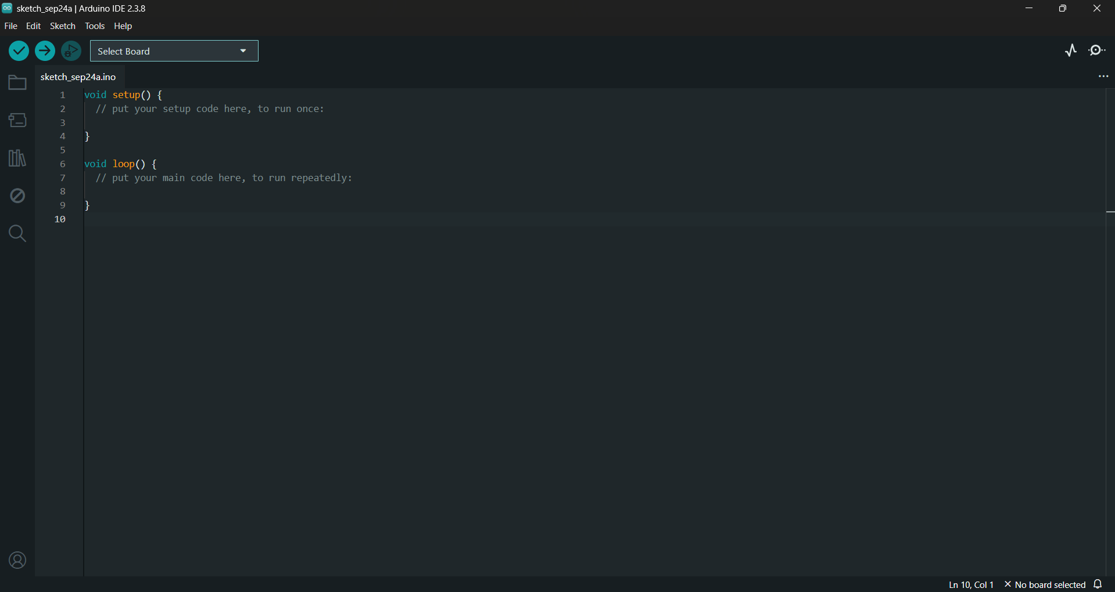
05
Hands-On Robotics Workshop
can we talk to a microcontroller?
Arduino IDE
The Arduino IDE (Integrated Development Environment) is the software you use to write, compile, and upload code to Arduino boards/Other Boards.
SESSION 1

Slide 7
06
Hands-On Robotics Workshop
Coding intro
Variable definition
Call back functions
API’s
Define Variable types, names.
Define used Pins.
Void setup()
Void loop()
pinMode()
digitalRead()
digitalWrite()
analogRead()
Parameters & Arguments
Let’s take look on these items in the IDE
Parameter = the placeholder variable in the function's definition. It's the name used inside the function to refer to whatever gets passed in.
Argument = the actual value you pass in when you call the function.
SESSION 1

Slide 8
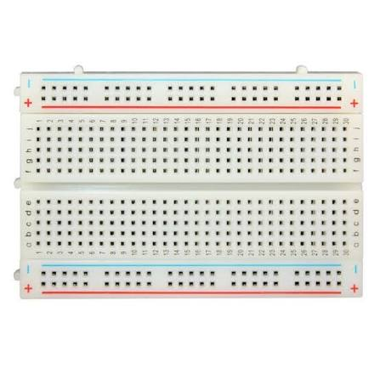
07
Hands-On Robotics Workshop
Breadboard
Each vertical line with 5 Dots is connected
Each horizontal line is connected
SESSION 1

Slide 9
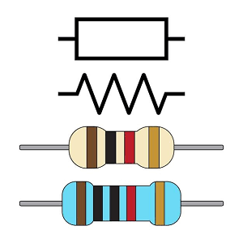
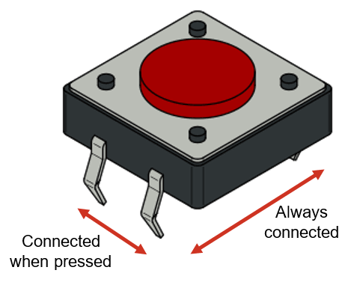
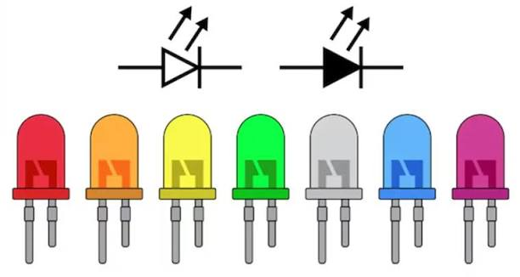
08
Hands-On Robotics Workshop
Resistor
Push button
LED
SESSION 1

Slide 10
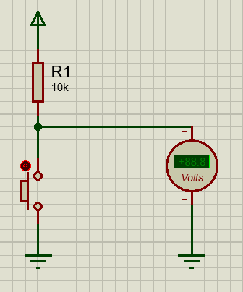
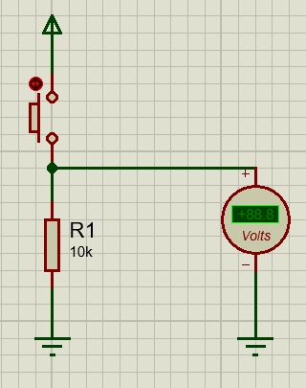
09
Hands-On Robotics Workshop
Pull up vs. Pull down
Floating Pin
A pin that is not connected to any defined voltage (neither VCC nor GND), so it picks up random electrical noise from the environment and gives unpredictable HIGH/LOW readings.
Pull Up
Pull Down
Resistor is connected to Vcc.
Pressed = OFF
Unpressed = ON
Resistor is connected to GND.
Pressed = ON
Unpressed = OFF
SESSION 1

Slide 11

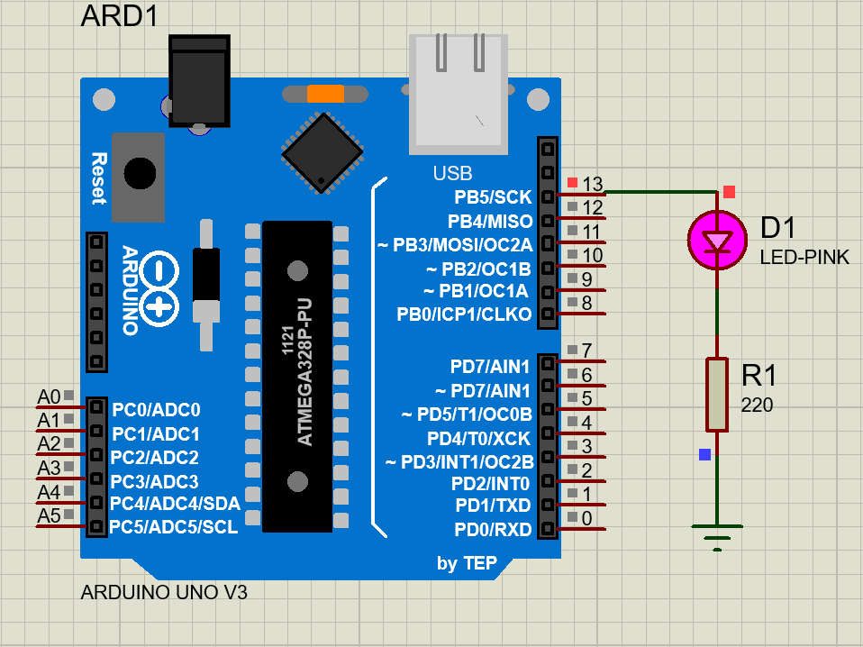
10
Hands-On Robotics Workshop
Exercise_1: LED Blink
1- Open simulation software (Proteus ) do the wiring
2- Open IDE and write the code
3- Burn the code on the microcontroller
SESSION 1

Slide 12
11
Hands-On Robotics Workshop
LAB_1
Use 3 LEDs, blink them to make the pattern you want
Try on simulation first, then hardware
SESSION 1

Slide 13
12
Hands-On Robotics Workshop
Conditional if
if (condition1) {
// runs if condition1 is true
}
else if (condition2) {
// runs if condition1 is false AND condition2 is true
}
else {
// runs if none of the above are true
}
SESSION 1

Slide 14
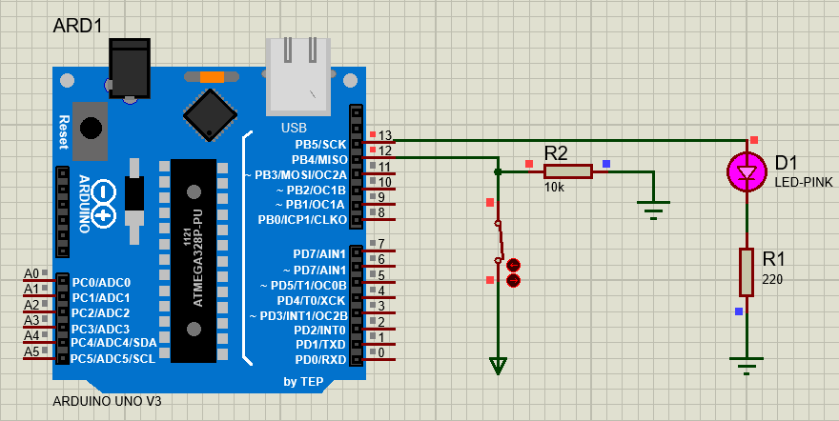
13
Hands-On Robotics Workshop
Exercise_2: LED Blink+Button
1- Open simulation software (Proteus ) do the wiring
2- Open IDE and write the code
3- Burn the code on the microcontroller
SESSION 1

Slide 15
14
Hands-On Robotics Workshop
LAB_2
Use 3 LEDs, blink them using the switches
Try on simulation first, then hardware
SESSION 1

Slide 16

Thank You

